Slide 1
Explanation of Why Diffusion Waves End
By Michelle Goodman

Slide 2
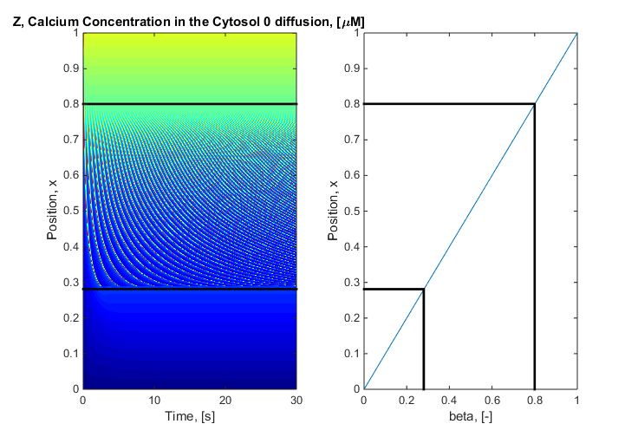
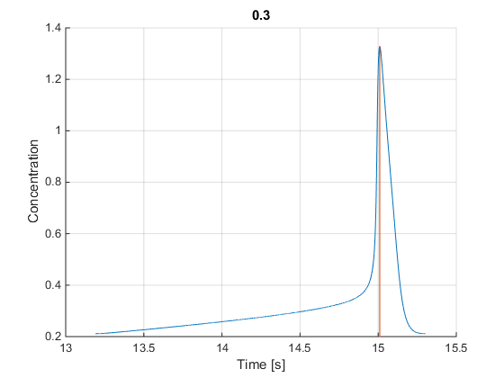
Global vs Position vs Single Wave Profile

Slide 3
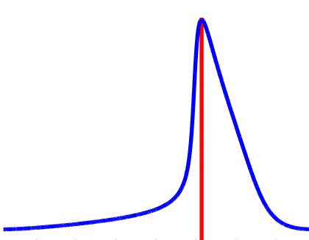
Position Wave Profile for 3 Positions
P_{above}
Note: The wave is front heavy
Rapid Increase
Slow Decrease
To do with the nonlinear terms in the Goldbeter
P₀
P_{below}
Global Wave Profile

Slide 4
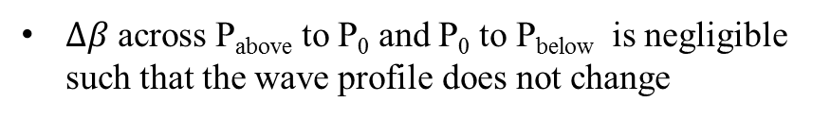
Position Wave Profile for 3 Positions
Assumptions:
P_{above}
$∆β$ across P_{above} to P₀ and P₀ to P_{below} is negligible such that the wave profile does not change
Addition of Diffusion to the solution is negligible difference to the single wave profile
The wave must be front heavy
P₀
P_{below}
Global Wave Profile

Slide 5
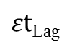
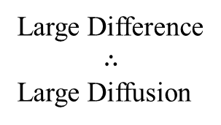
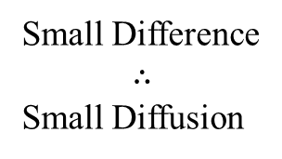
Single Wave Profile for 3 Positions
Diffusion is proportional to
the difference in concentration
between two cells
Small Difference
$$∴$$
Small Diffusion
Large Difference
$$∴$$
Large Diffusion
$εt$_{Lag}
P_{above} P₀ P_{below}

Slide 6
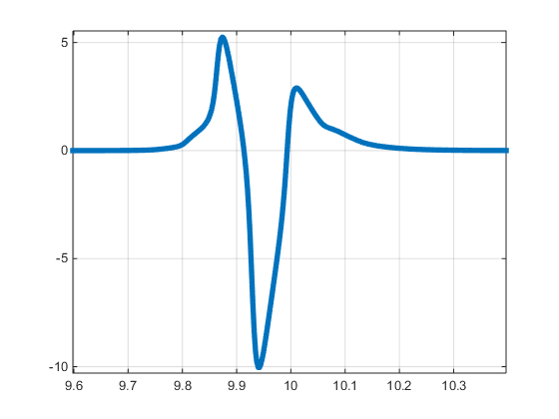
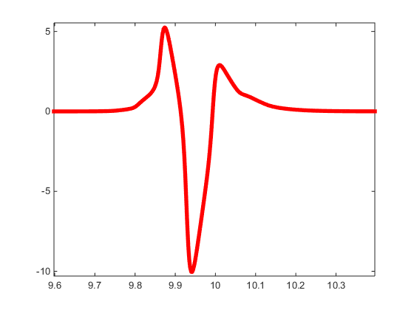
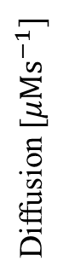
Diffusion Profile As Wave Passes
Diffusion coming in from cell Above
Diffusion coming in from cell Below
Diffusion [$μMs^{−1}]$
Diffusion leaving to cells above and below
Time [s]

Slide 7
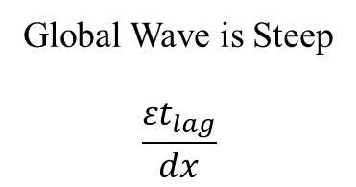
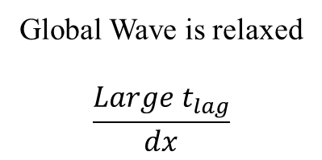
Single Wave Profile for 3 Positions
P₋₁
Global Wave is Steep
$$\frac{{εt}_{lag}}{dx}$$
Global Wave is relaxed
$$\frac{{Large t}_{lag}}{dx}$$
P₀
P₊₁

Slide 8
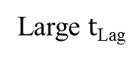
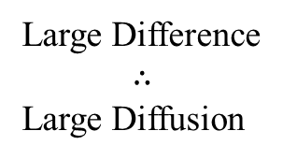
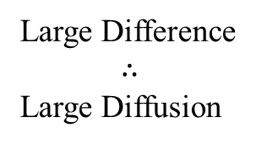
Single Wave Profile for 3 Positions
Diffusion is proportional to
the difference in concentration
between two cells
Large Difference
$$∴$$
Large Diffusion
Large Difference
$$∴$$
Large Diffusion
Large $t$_{Lag}
P_{above} P₀ P_{below}

Slide 9
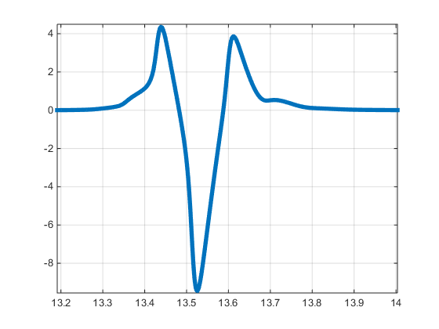
Diffusion Profile As Wave Passes
The amount of diffusion coming in from above
The amount of diffusion coming in from below
=
Diffusion
The Global Wave Stops
Time [s]

Slide 10
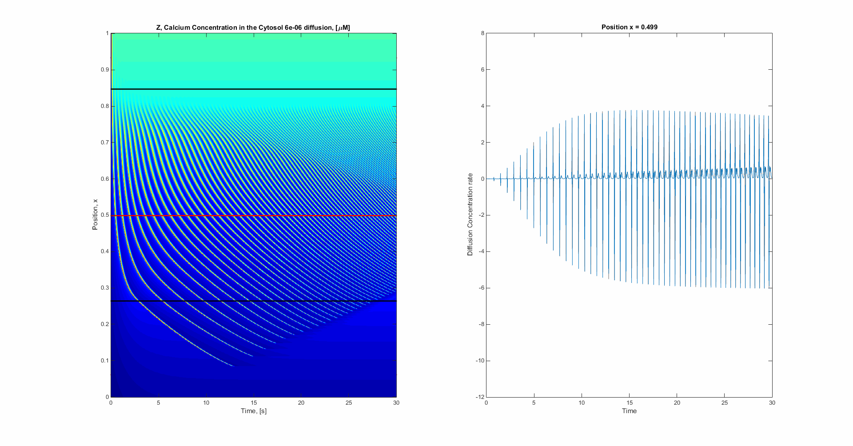

When Diffusion coming in from cell Above = Diffusion coming in from cell Below
Then the Global wave profile stops
As the gradient of the Global profile increases (becomes more relaxed) the Diffusion coming in from the cell below increases
Diffusion coming in from cell Above
Diffusion coming in from cell Below
Diffusion leaving to cells above and below

Slide 11
Summary
For each positon there is an associated:
Beta
Different single wave profile
Gradient of the Global wave profile (some t_{lag})
Such that the wave will stop
Questions:
What is the relationship between beta, the single wave profile and t_{lag} for zero diffusion?
Can we extrapolate this relationship into the region below the bifurcation point? Thus predicting the diffusion case
What is the shape of the Global Wave profile determined by?
Can you determine $β$ from the concentration profile?
Diffusion must change the shape of the wave

